Slide 1
Apache Kafka

Slide 2
What is Apache Kafka?
It is messaging service(queue).
It includes Offline / Online Messaging.

Slide 3
How it works?
Producer send message (event) to kafka(storage).
Kafka stores message. Also, it replicates message.
Cunsomer(listener) subscribes to topic event for consuming.
There may be more than one consumer. (asynchronous messaging)

Slide 4
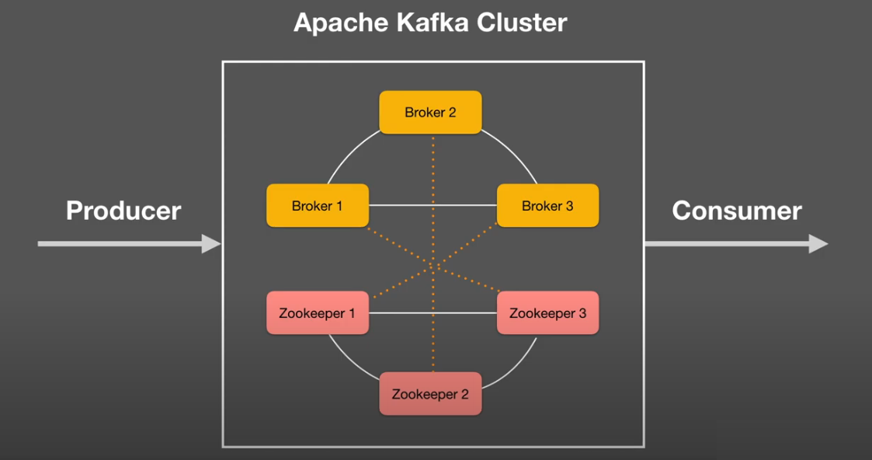
Apache Kafka Architecture

Slide 5
Replication
It is the duplication of a data as many as the desired number.

Slide 6
Split Brain

Slide 7
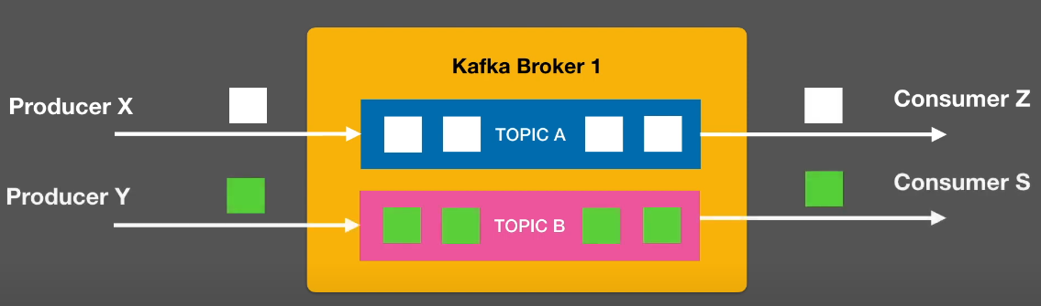
How does Kafka store data?

Slide 8
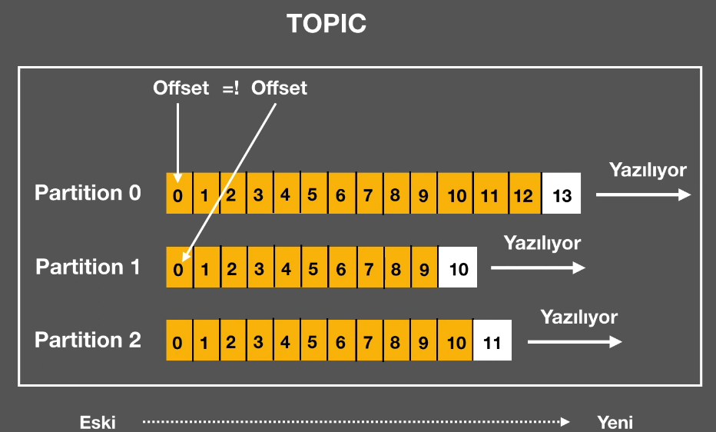
Topic – Partition (1)

Slide 9
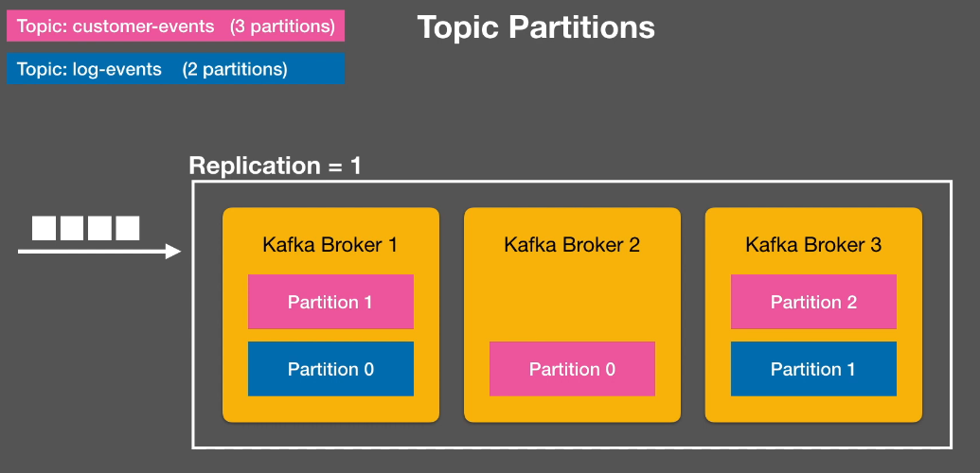
Topic – Partition (2)

Slide 10
Why we need partition?
Aggregation: collecting the data of the producers according to the determined features
Sorting (event sourcing): sequential collection of data
Parallelism: read data faster
Efficiency: storing data more efficiently

Slide 11
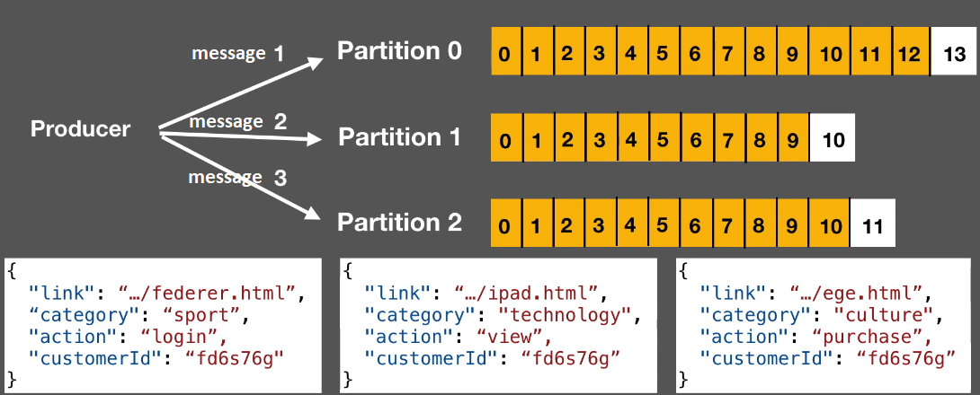
Topic Partitions – Record Key
Default
Round-Robin

Slide 12
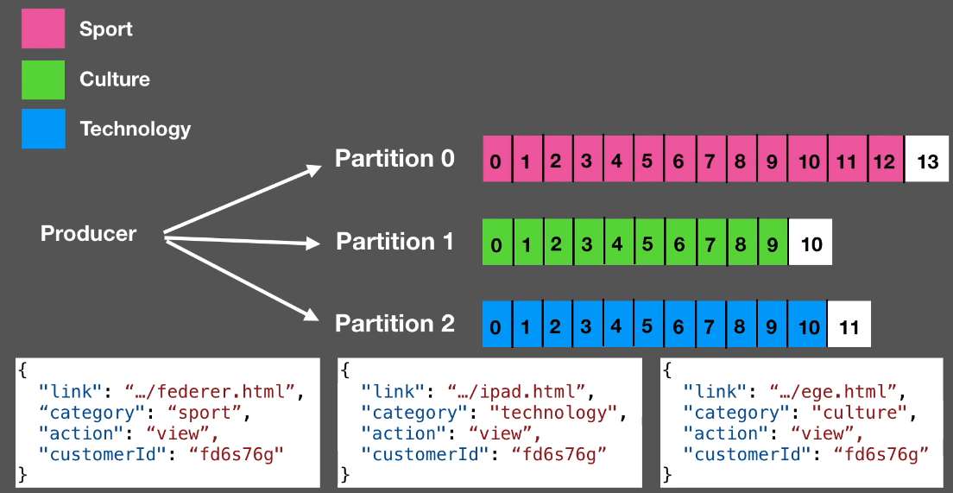
Topic Partitions – Record Key
record.key = “category value”
Aggregation

Slide 13
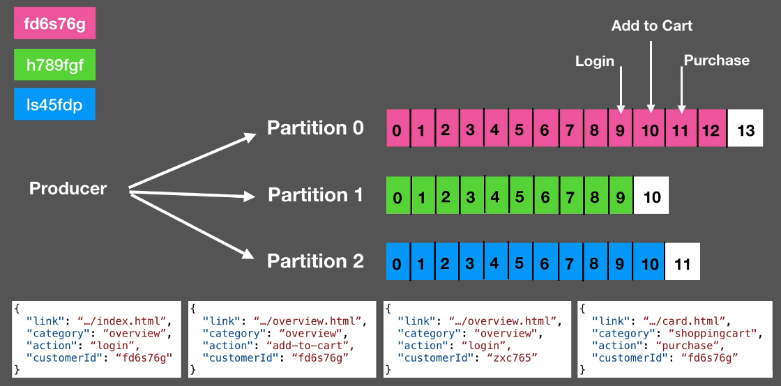
Topic Partitions – Record Key
record.key = “customerId value”
Sorting (Event Sourcing)

Slide 14
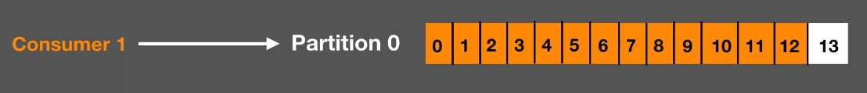
No Parallelism

Slide 15
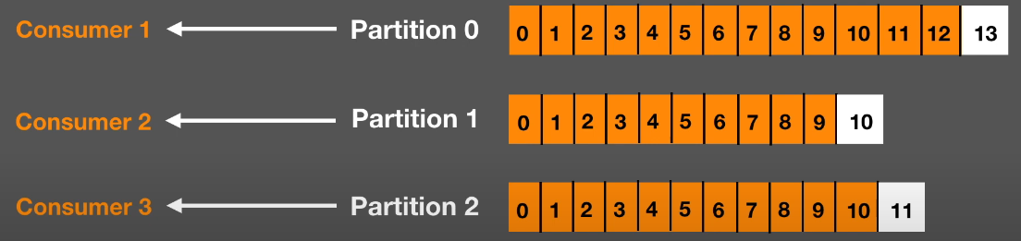
3 Parallelism

Slide 16
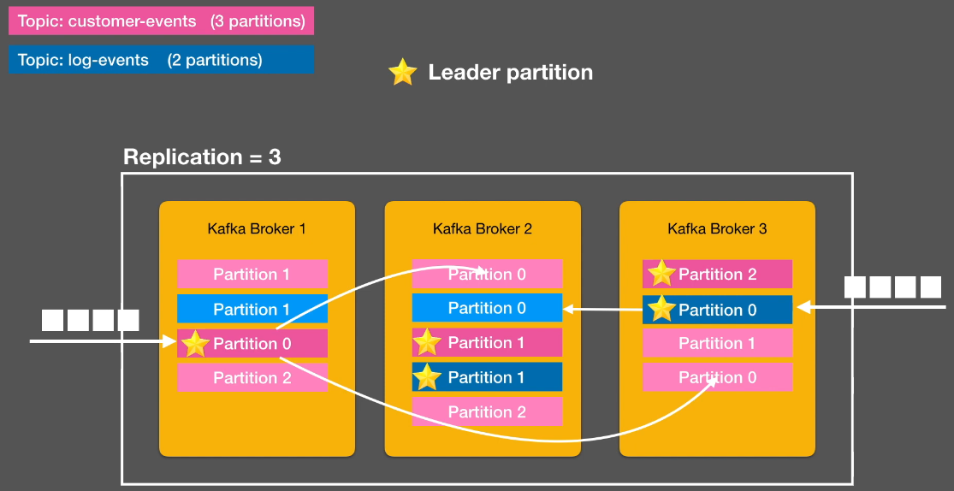
Replication

Slide 17
Producer Acknowledgement
acks = 0 (fastest and riskiest, high chance of message loss) send to kafka and continue without waiting for reply
acks = 1 (moderately fast and secure, little chance of message being lost) send it to the kafka and just wait until it written by leader
acks = all,-1 (slowest and safest, no chance of message lost) send to kafka, wait for leader to write and other leader partitions(copy partitions) to write

Slide 18
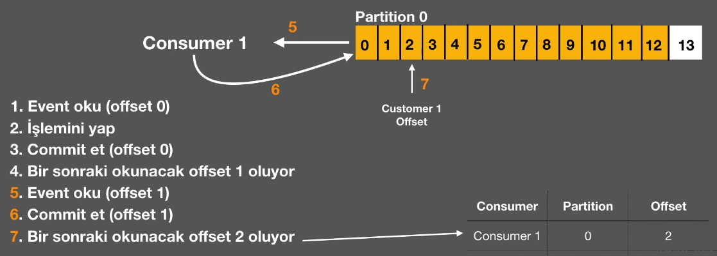
Read Data from Kafka

Slide 19
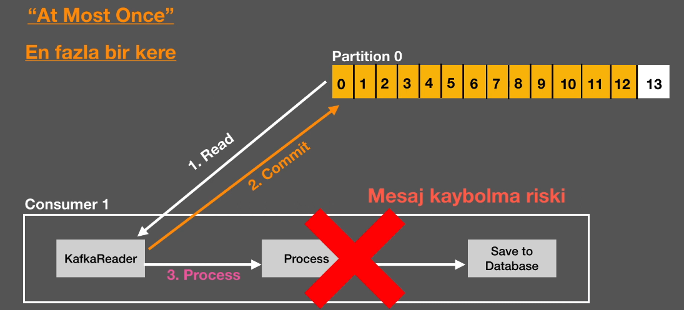
Data Reading Strategies from Kafka(1)

Slide 20
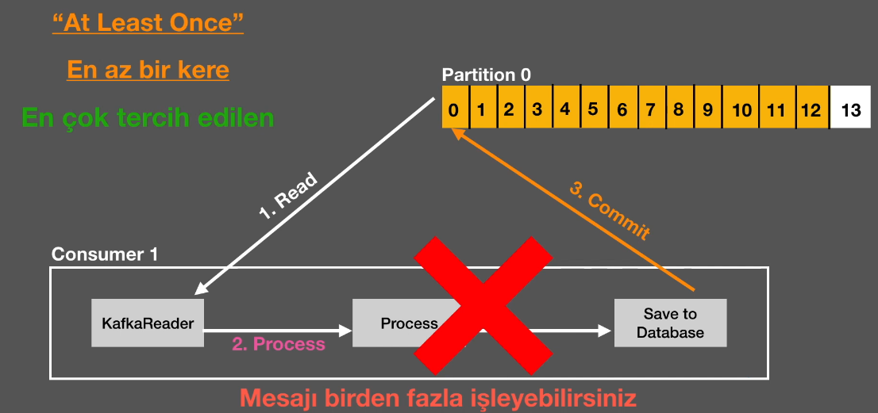
Data Reading Strategies from Kafka (2)

Slide 21
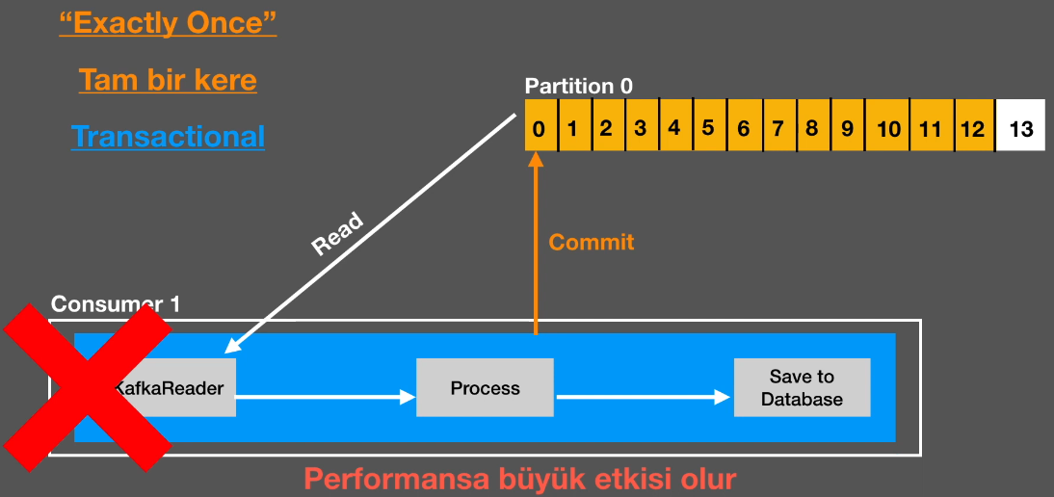
Data Reading Strategies from Kafka (3)

Slide 22
Consumer Groups
Only one reader with the same name can read from a partition.

